Slide 1
GROUP :- I - 01
NAME | ROLL NO | ENROLLMENT NO
PRAJAPATI MEET | 22I051 | 22BCA04422
PRAJAPATI PRATIK | 22I052 | 22BCA04428
PRAJAPATI VAIDIP | 22I053 | 22BCA04437
JADAV HARSH | 22I016 | 22BCA04143
PATEL UTSAV | 22I047 | 22BCA04385
VAGHELA AJAY | 22I066 | 22BCA04550

Slide 2
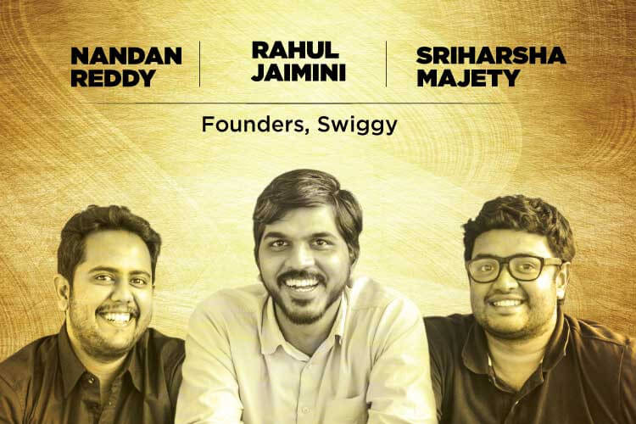
INTRODUCTION
Swiggy was founded in August 2014 by Nandan Reddy, Sriharsha Majety & Rahul Jaimini.
OrderingOrdering food online & providing delivery solutions at your doorstep from the best restaurants in your neighborhood.
Accepts online payments for all orders with no minimum order policy.
Headquarters:- Bangalore, Karnataka, India

Slide 3
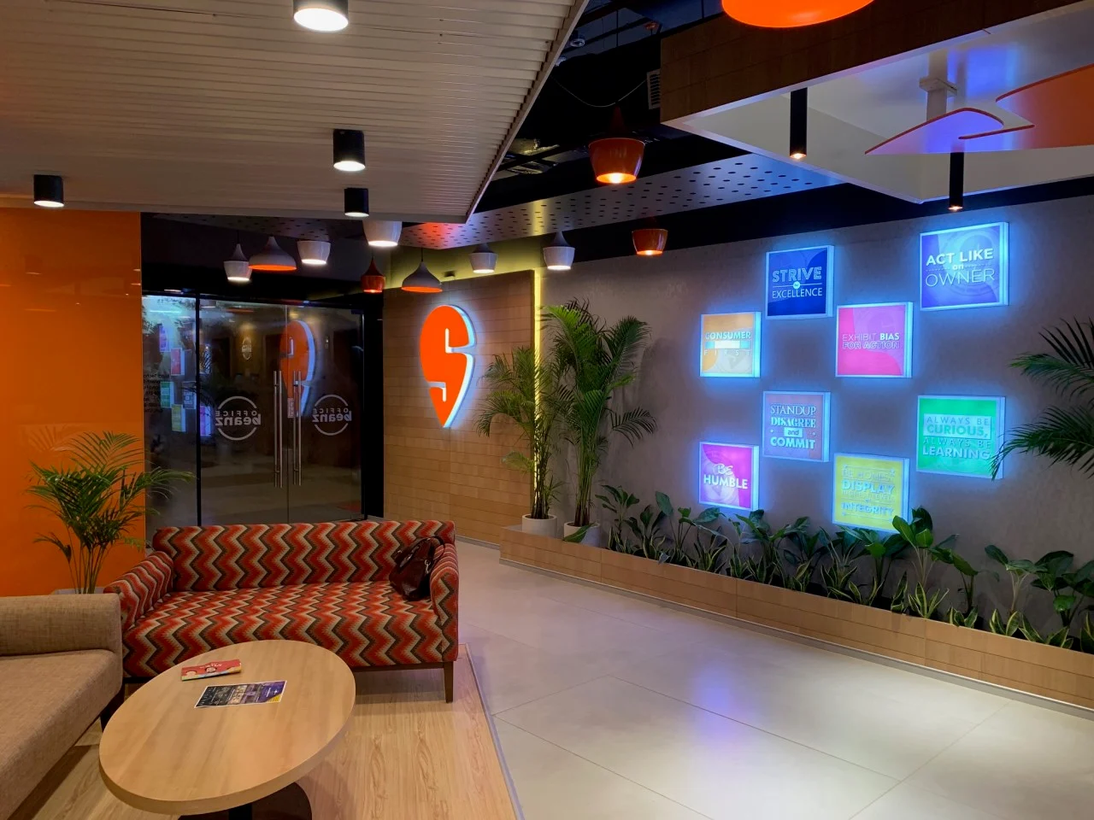
How Swiggy Started
Swiggy came into existence in the year 2014 when two BITS Pilani graduates, Sriharsha Majety and Nandan Reddy came up with the concept ‘Hyper local food delivery’.
They get acquainted with Rahul Jaimini, who rejuvenated this vision with a principle site.
In May 2015, Swiggy raised its initial round of financing and came up with the application.
Through this innovative app, one can get incredible food right to their doorstep and evolve their living standard.
Now, Swiggy is getting almost 5 Million traffic per month organically with more than 6.5 thousand backlinks.

Slide 4
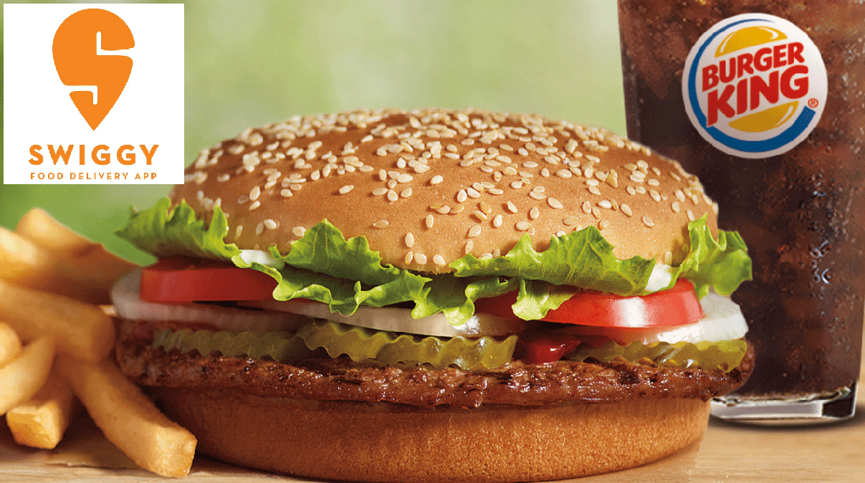
Swiggy Partnerships
Swiggy has joined hands with the fastest-growing fast-food outlet, Burger King, Goli Vada Pav, Cafe Coffee Day for giving delivery services.
It additionally has cooperated with Google Local Guide to encourage client reviews and with Sodexo to empower clients for paying through metal cards.
It banded together with Indifi Technologies to encourage a financing program for restaurant partners.
Swiggy launched its own payment wallet ‘Swiggy Money’ in partnership with ICICI bank.

Slide 5
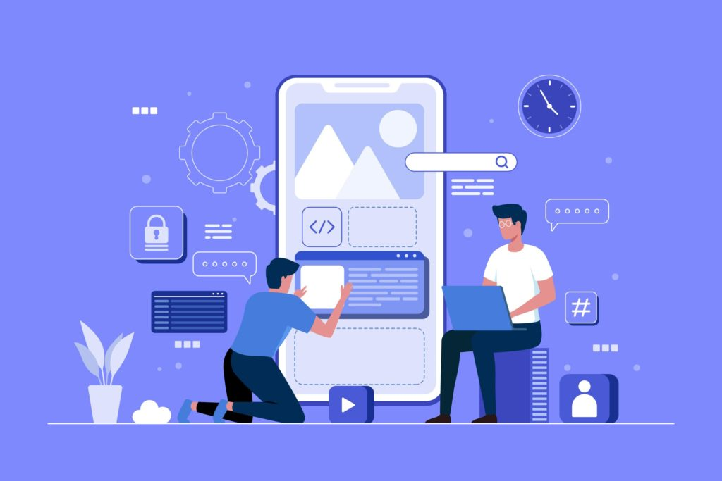
TECHNICAL SPECIFICATION
Swiggy uses 34 technology products and services including HTML5 , jQuery , and Google Analytics , according to G2 Stack.
Swiggy has a mobile application for both Android and iOS platforms. The Android app is built using Java and Kotlin, while the iOS app is built using Swift.

Slide 6
History
In 2013 two founders, Sriharsha Majety and Nandan Reddy designed an e-commerce website called “Bundl” to facilitate courier service and ship goods within India. Bundl was quickly paused, and they moved into the food delivery market.
At the time, the food delivery sector was in turmoil as several notable startups, such as Foodpanda (later acquired by Ola Cabs), TinyOwl (later acquired by Zomato), and Ola Cafe (later closed) were struggling.
Majety and Reddy approached Rahul Jaimini, formerly with Myntra, and founded Swiggy and parent holding company Bundl Technologies in 2014.

Slide 7
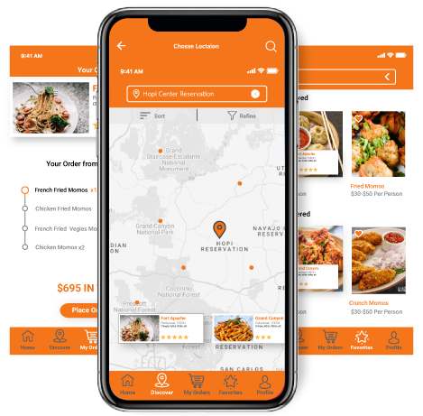
More about Swiggy
Swiggy currently stands with a net worth of 3.6 billion at the end of the financial year 2020.
From 2019, Swiggy underwent its expansion from 17 cities to 245 locations and is planning to expand it furthermore.
Another vision of the company is the transformation into an AI (Artificial Intelligence) first product.
Swiggy also made the two investments in the Fingerlix with the total amount of $143 million.

Slide 8
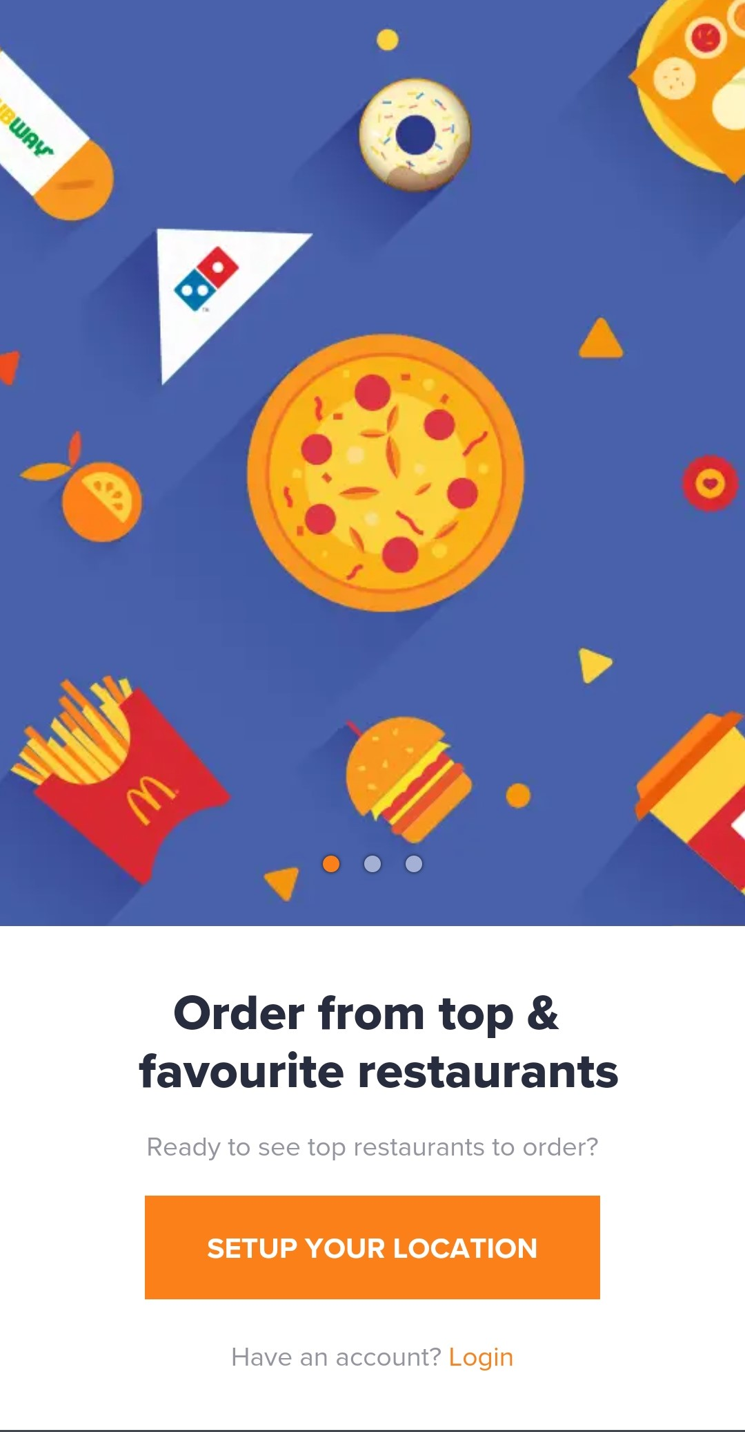
STEP 1
Download the Swiggy App from your Playstore or iOS App Store. Or simply visit www.swiggy.com.

Slide 9
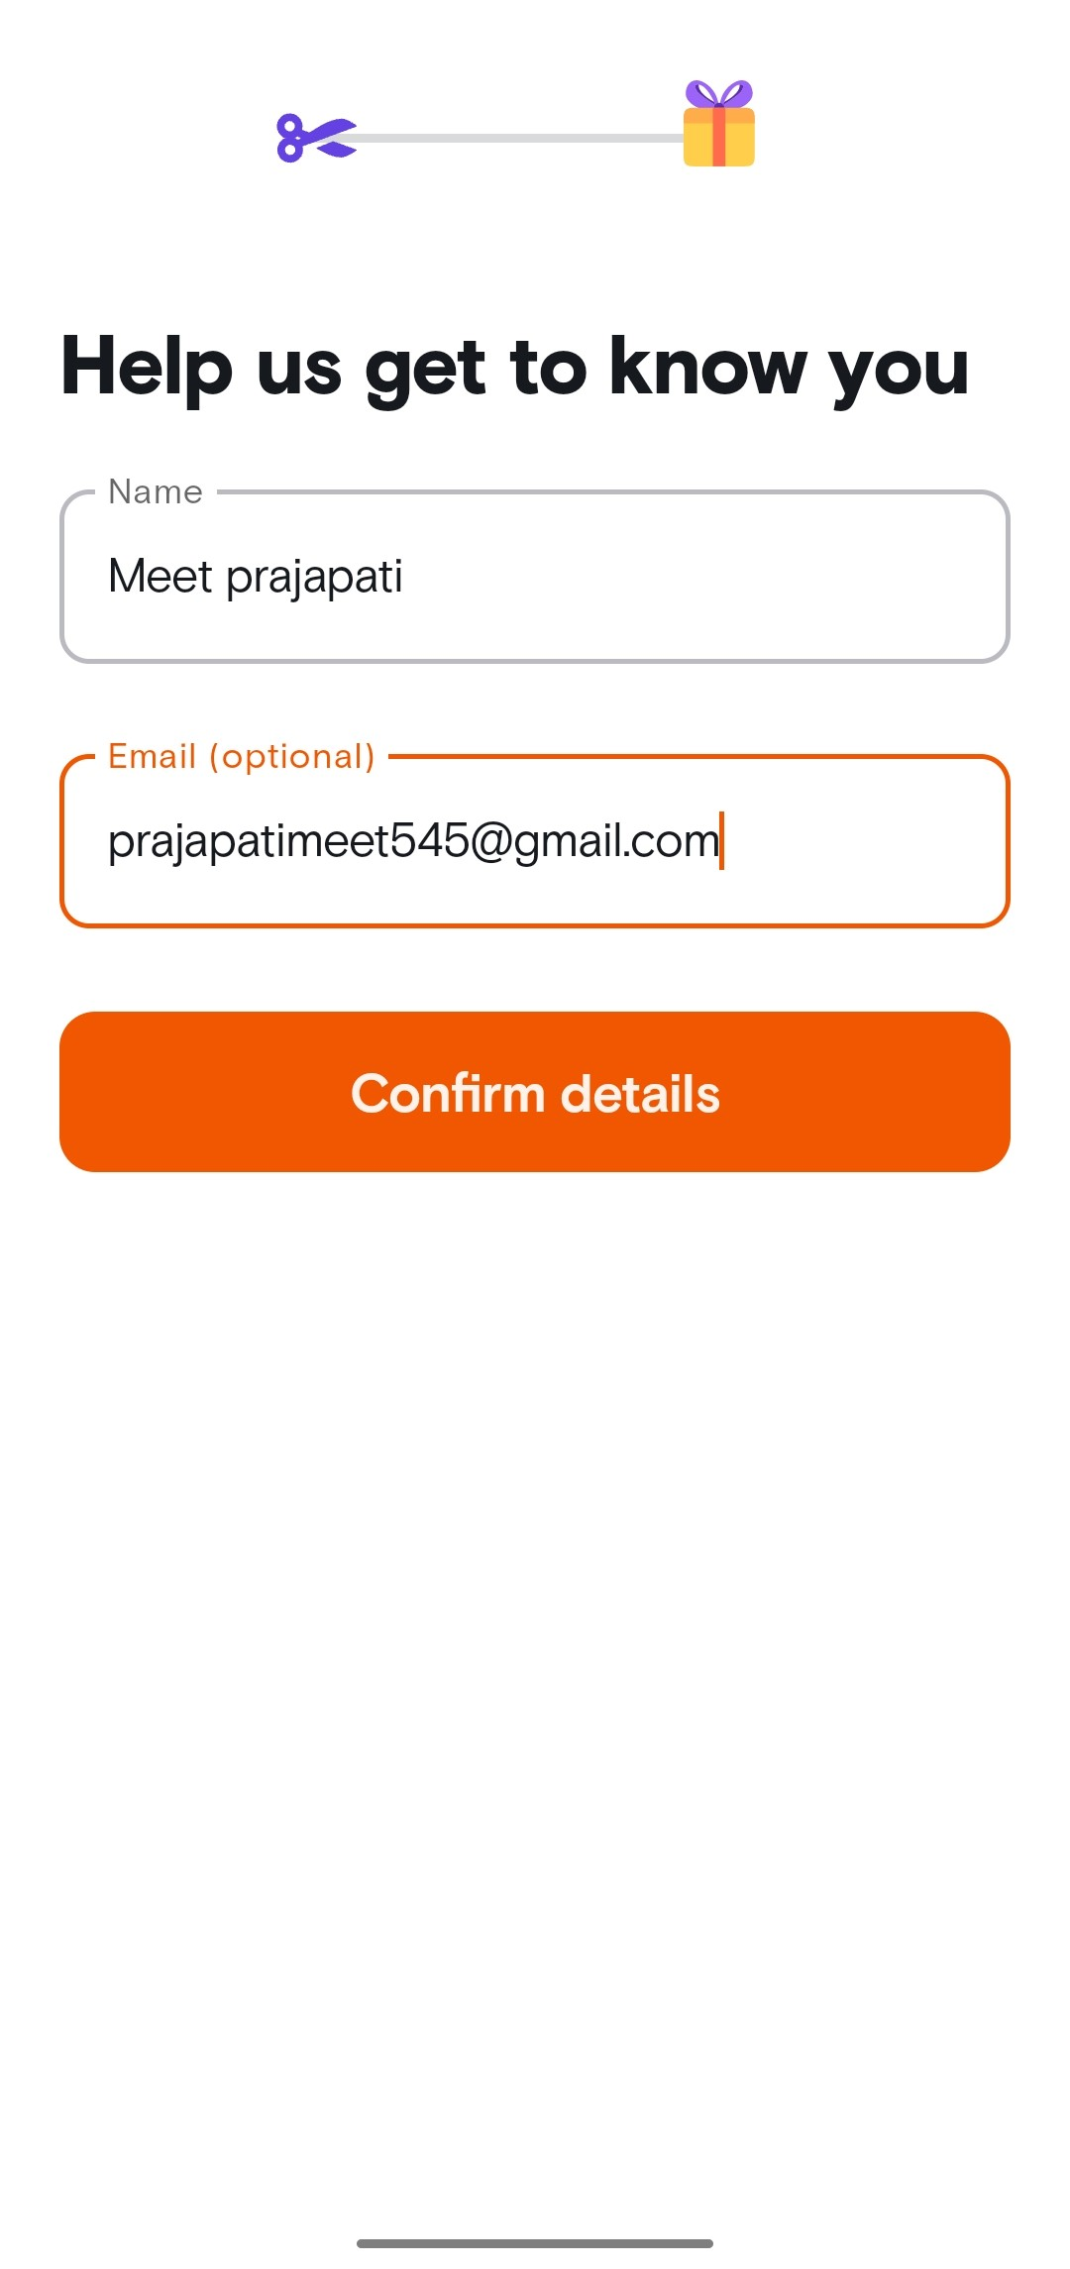
STEP 2
Sign up on the App/website using your credentials.

Slide 10
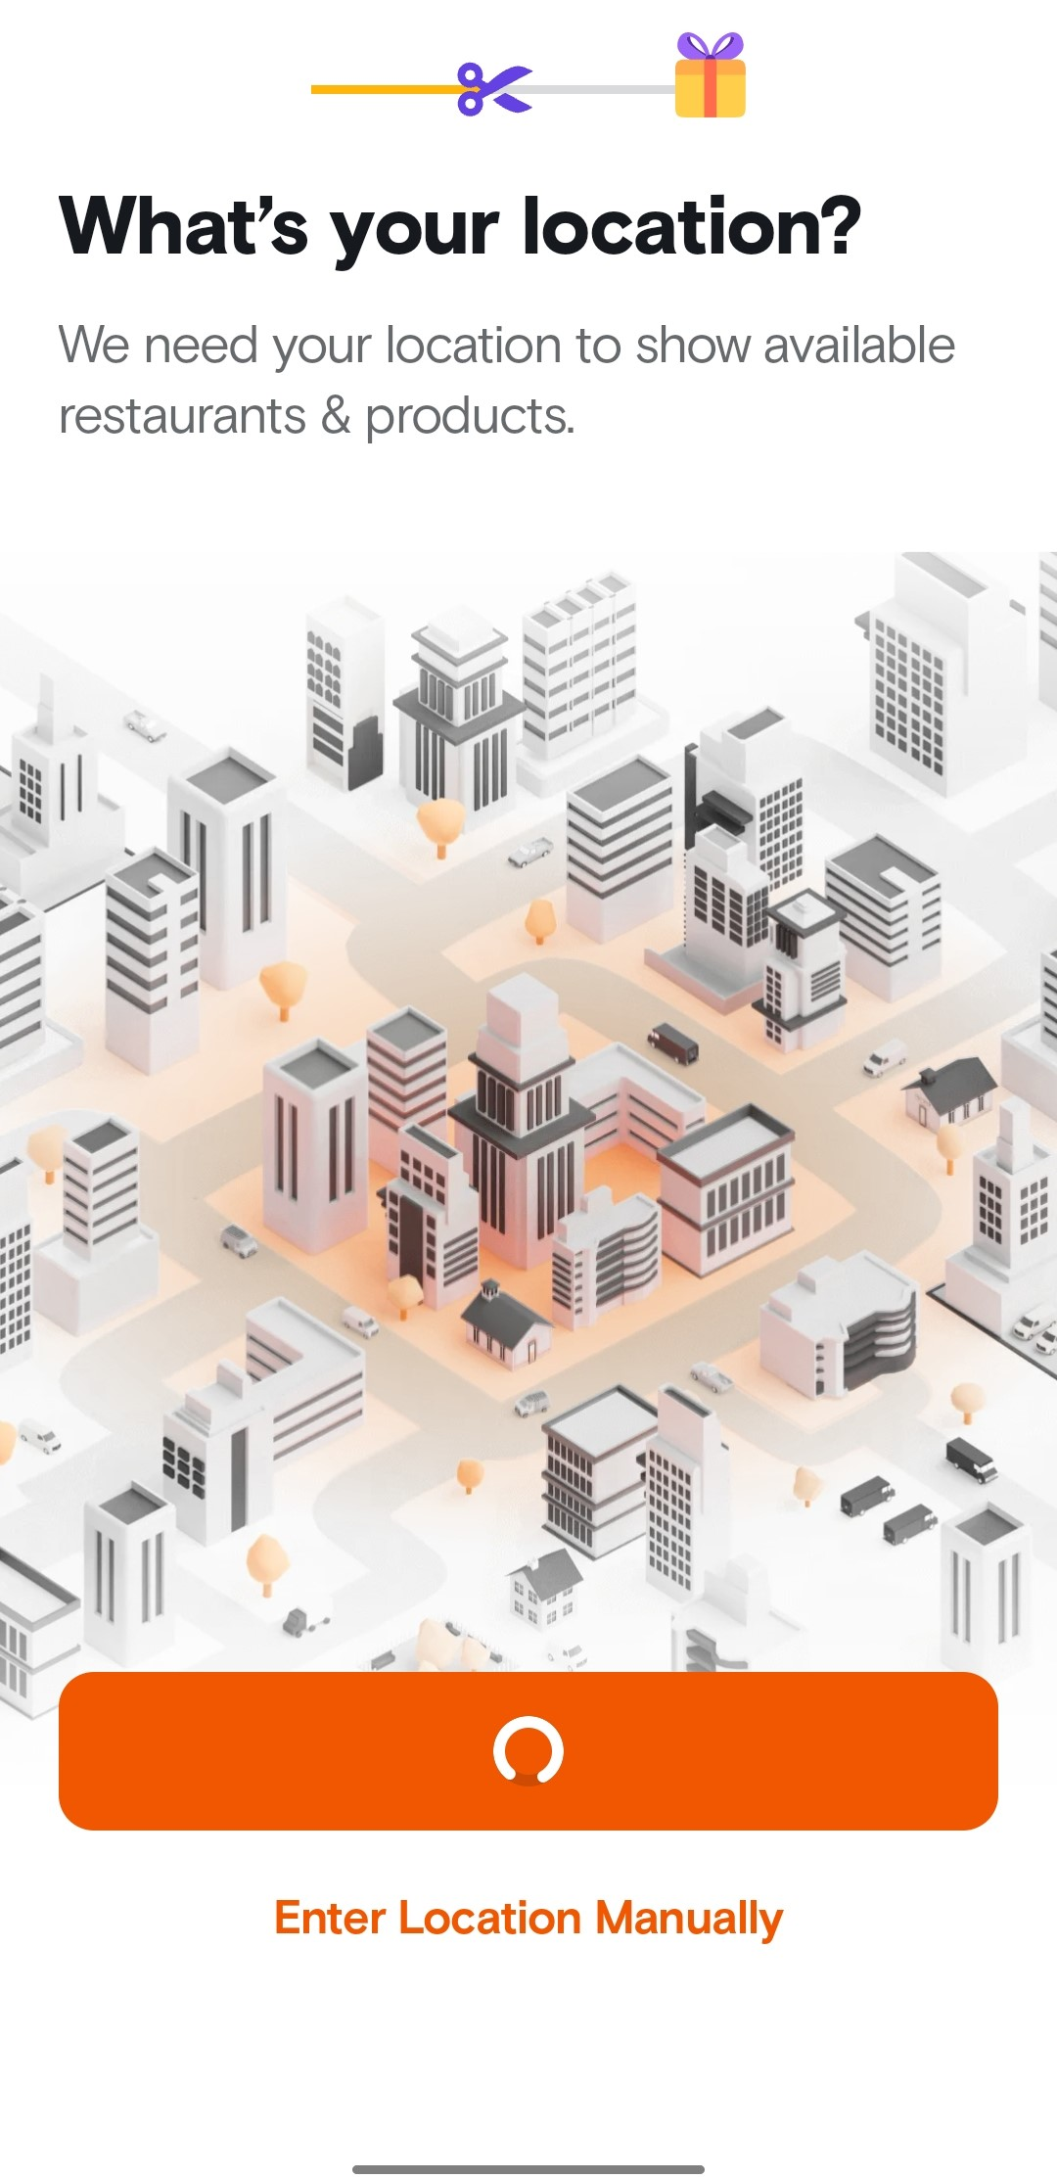
STEP 3
Now, enter your delivery location or simply click on ‘Locate Me’ option.

Slide 11
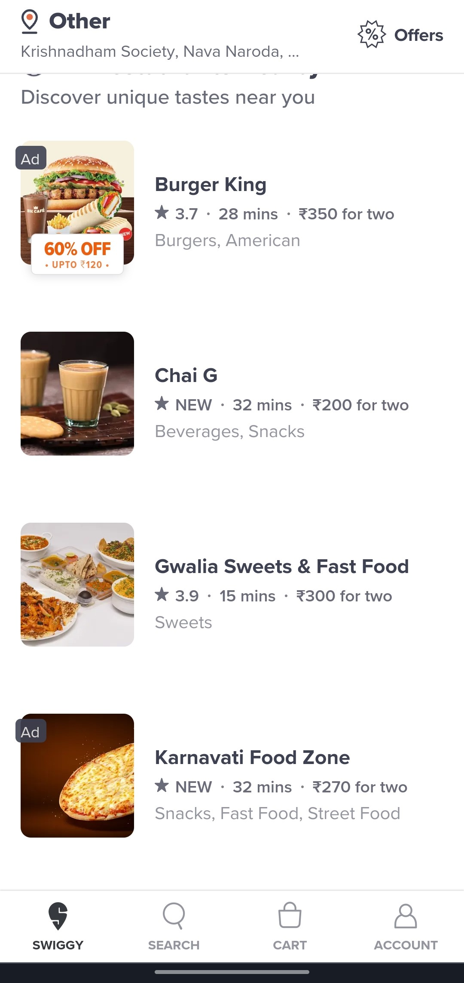
STEP 4
After fetching your location, Swiggy shows you all the partnered restaurants near you. You can also check out Swiggy Pop if you wish to find food items under Rs. 99.

Slide 12
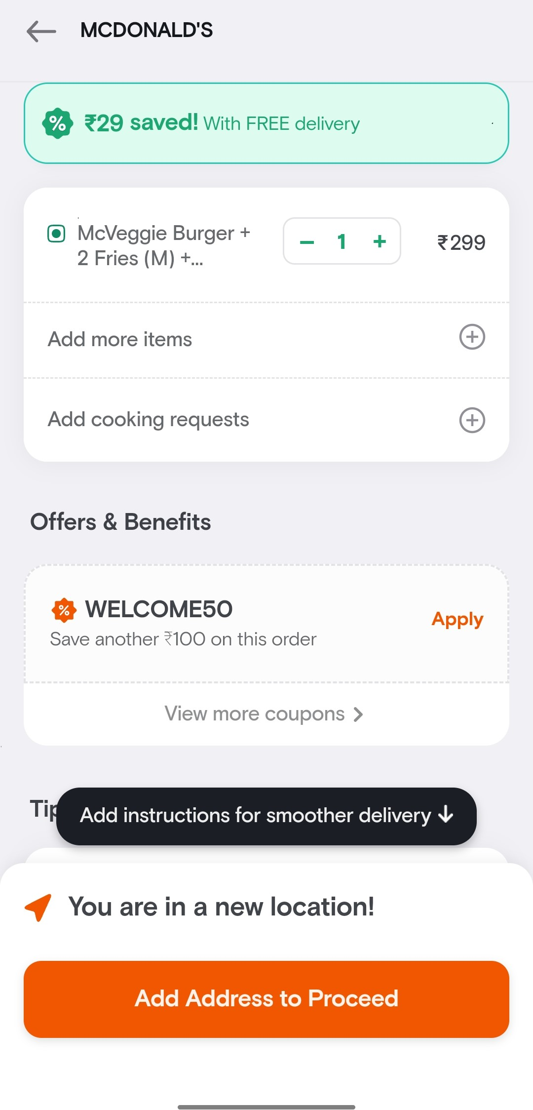
STEP 5
Tap on the restaurant/food item you wish to add to your cart. Select the preferred restaurant franchise you want to order from.

Slide 13
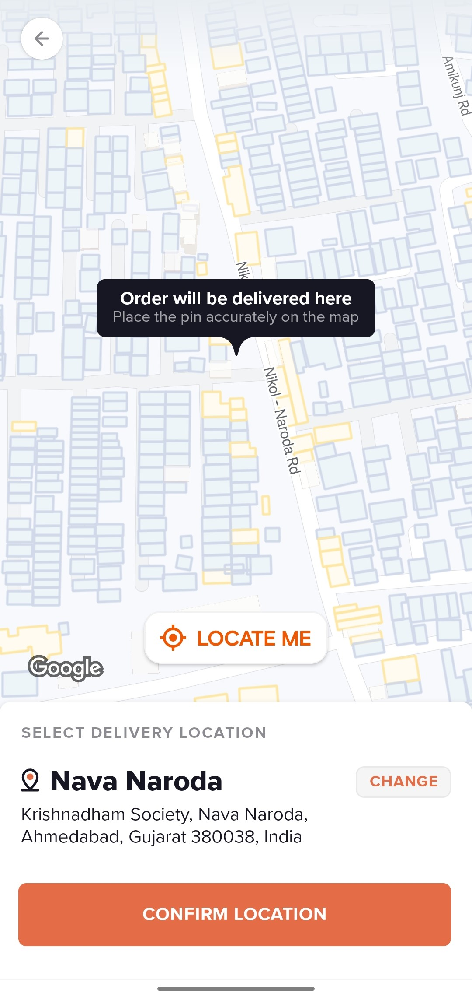
STEP 6
Add your address and click on ‘Save & Proceed’.

Slide 14
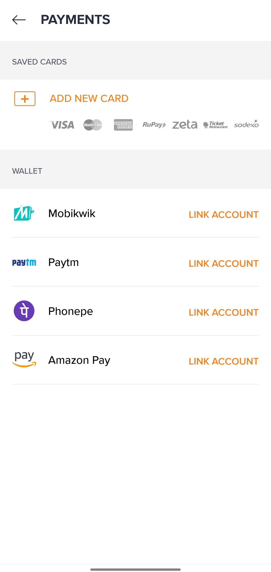
STEP 7
Select the preferred payment method and pay for your order. You can check the order details and the estimated time of delivery on the App or website. The best part is that you can track your order too.

Slide 15
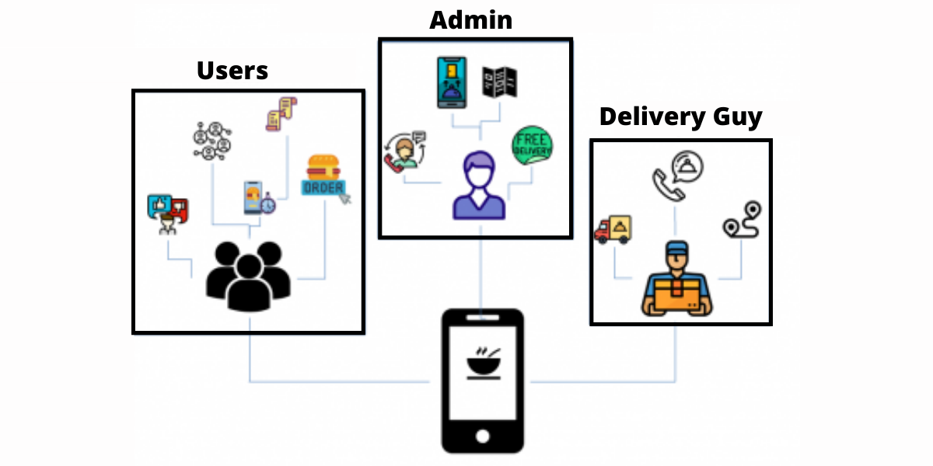
ROLE OF SELLER
Registration: Sellers need to sign up and create an account on the platform, providing necessary information for verification and setting up their online store.
Login: After registration, sellers can log in to their accounts to access their dashboard and manage their products, orders, and other settings.
Sell: Sellers can list their products on the platform, including details such as product descriptions, prices, images, and quantities available for sale.
Deliver: Once an order is placed by a customer, the seller isresponsible for packaging and shipping the product to the customer's address.
Commission: The platform usually charges a commission or fee for each successful sale, which contributes to the platform’ srevenue.

Slide 16
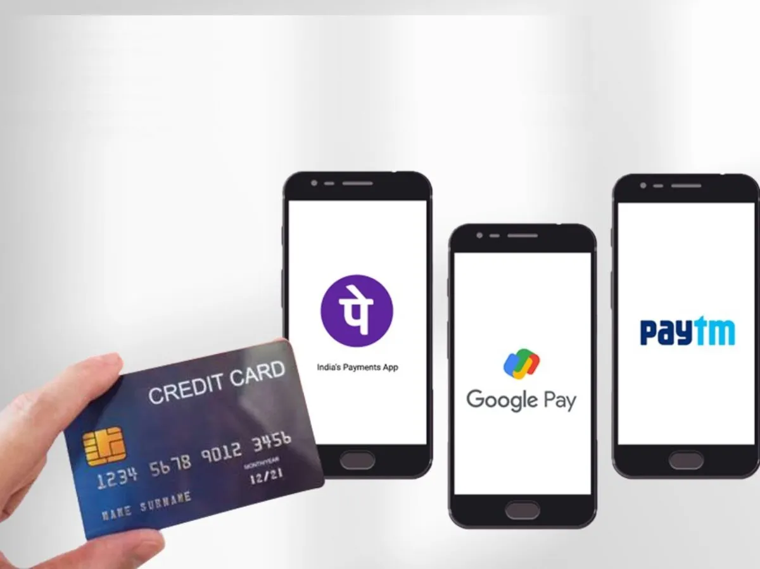
PAYMENT TYPES
Debit and Credit Cards: The app's net banking facility will allow you to use credit and debit cards.
Sodexo and Other Meal Cards: If you have meal cards, you can use it on your food orders.
PhonePe. This is the simplest digital wallet option to make your Swiggy payment.
Paytm.
Mobikwik.
Freecharge

Slide 17
ADVANTAGES
No Minimum Order :-
Swiggy offers you no restriction in order value and, you can even order for a minimum amount. Thus, you can order food for yourself and to your friends.
Fast Delivery :-
Swiggy promises to deliver food in 40 minutes and holds an average delivery time 37 minutes. So, Food delivery with Swiggy is super fast.
Distance Coverage :-
The most important benefits of Swiggy is its coverage of distance. You can order from the restaurant that is far from your location using Swiggy. This option also gives the opportunity to try various restaurants in the surrounding.
Live Tracking :-
Now the users no need to worry about the order as Swiggy keeps updating them about order status. The users can also track the live location of the driver to make thing further easy.
Order Cancellation :-
Swiggy doesn’t charge their user for canceling their order before it’s confirmed. But when the order is confirmed then Swiggy charges a cancelation fee based on order amount.

Slide 18
DISADVANTAGES
1. Limited Service Area
Despite its many advantages, there are also some disadvantages to using Swiggy that might make users in certain areas think twice before placing an order. One of the main drawbacks is that the service is only available in a limited number of cities in India, which means that users in certain areas may be out of luck.
2. Dependence On Delivery Partners
Additionally, Swiggy relies on a network of delivery partners to make its deliveries, which can sometimes lead to delays or issues with the quality of service. Think about it, you’ve been waiting eagerly for your food to arrive, but it gets delayed due to unforeseen circumstances with the delivery partner, which can be quite frustrating.
3. Higher Prices Compared To Other Food Delivery Services
Swiggy’s focus on premium restaurants and cuisines means that users have access to some of the best and most exclusive eateries in town. But, with this exclusivity comes a higher price point. So, if you’re looking to indulge in some culinary delights without breaking the bank, you may want to consider other options

Slide 19


